Slide 1
Generating Reminders/Recalls and Coverage Rate Report in ImpactSIIS
Last updated : 4/8/2026.

Slide 2
GENERATING A REMINDER/RECALL REPORT IN IMPACTSIIS
Reminder/Recall allows providers to notify patients about upcoming or past due vaccinations. Only the patients last vaccinated in your specific Organization or Facility are included in the Reminder/Recall results.
Notifications can be generated in the following formats:
Generate a Patient List - Generates an HTML file that displays a detailed list of patients, including their vaccination forecast.
Print Letters - Generates a reminder/recall letter for each patient in the patient list.
Generate Auto-Dialer Content - Generates an HTML file that can be used with any external auto-dialer application.
Generate Mail-Merge - Generates a text file that can be used with any external mail merge application.
Create Custom Postcards - Provides the ability to create custom postcards as reminder/recall notifications. You can define the dimensions of the postcard, as well as the message content.
Send Email - Provides the ability to send reminder/recall notifications using patient email addresses.

Slide 3
GENERATING A COVERAGE RATE REPORT IN IMPACTSIIS
The COVERAGE RATE REPORT produces coverage rate data for a provider and displays the following information in a table:
Complete by vaccine.
Complete by series.
Incomplete series.
One dose away to complete series.
One visit away from a complete series (multiple doses needed that can be given within one visit to vaccinator).
Not Yet Due.
Not Yet Due (Late by Age).
Missed opportunities.

Slide 4
Ohio Polling Data & Managing Immunization Schedule Updates
May 5, 2026

Slide 5
Agenda
Ohio Immunization Polling Data Review
AAP Immunization Schedule
Resources
Q & A

Slide 6
Ohio Immunization Polling Data Review

Slide 7
Poll Details
Ohio AAP partnered with BGSU Democracy & Public Policy Research Network
800 statewide voters
Conducted from October 2 to October 14, 2025
Margin of error of +/- 4.5 percentage points
Sample’s weighting reflects a +10 margin for Trump in the 2024 presidential race.

Slide 8
Poll Summary
Most Ohioans support childhood vaccines and trust their doctors,
but confusion driven by mixed messaging continues to shape
public opinion.

Slide 9
87% of Ohioans think that it’s very important or important that parents get their kids vaccinated.
Notes:
This is especially true for individuals who lean more liberal highlighting that vaccines are still politically polarized. 98% of Democrats think is very important or important that parents get their kids vaccinated. Overall, only 3% of respondents thought that it wasn’t important at all that parents get their children vaccinated.

Slide 10
86% of Ohioans think routine vaccines are very safe or safe for most children.
Notes:
Routine vaccines do NOT include COVID-19.

Slide 11
89% indicated they were very confident or fairly confident that their pediatrician/family physician provides them with the information they need to make informed decisions about vaccines.
Notes:
Studies have shown that a strong provider recommendation significantly boosts patient acceptance of vaccines. Even in the age of social media, doctors remain the most credible voice on vaccines by a wide margin. Only 2% of respondents were not confident at all that their pediatrician or family physician provided them with information they need to make informed decisions about vaccines.

Slide 12
75% of Ohioans believe that parents should be required to have their children vaccinated against preventable diseases.
Notes:
The key word here is “required” as in required for attendance in daycare and/or school.

Slide 13
43% of respondents felt confident or very confident in the safety of the COVID-19 vaccine; whereas 83% felt confident or very confident in the MMR vaccine, and 85% in the polio vaccine.
Notes:
Confidence regarding vaccine safety again really highlights the political divide in the U.S. Only 7% of Republicans are confident in the safety of the COVID-19 vaccine, while 49% of Democrats are confident. The same is true for long-standing vaccines like MMR and Polio. Republicans are only 48% and 53% confident in the safety of MMR and polio vaccines respectively. While Democrats are 85% confident in the safety of MMR and 84% confident in the safety of the polio vaccine.
This data shows skepticism is vaccine-specific, not anti-vaccine across the board.

Slide 14
88% of Ohioans think that health insurers, including Medicaid & Medicare, should be required to pay for vaccines that individuals choose for themselves or family members.
Notes:
This is especially important now due to the recent changes to the CDC Childhood Immunization Schedule. Almost everyone agrees that if a parent wants a vaccine for their child, they should NOT be paying out of pocket for that vaccine. Support remains high across political parties, suggesting vaccine access is less controversial than mandates.

Slide 15
82% of Ohioans have heard about the benefits of vaccinations for children.
Notes:
In comparison, only 55% of individuals have heard about the “dangers” of vaccines. Most of this is due to mis and disinformation.

Slide 16
83% of Ohioans do not trust at all or only slightly trust their social media feeds to provide reliable information about vaccines.
Notes:
Only 5% of respondents completely trust or mostly trust their social media feeds to provide reliable information about vaccines. Social media platforms have high levels of both accurate information and misinformation, making it hard for users to assess credibility. Those who rely primarily on social media for vaccine information are more likely to hold misinformed views.

Slide 17
AAP Immunization Schedule

Slide 18
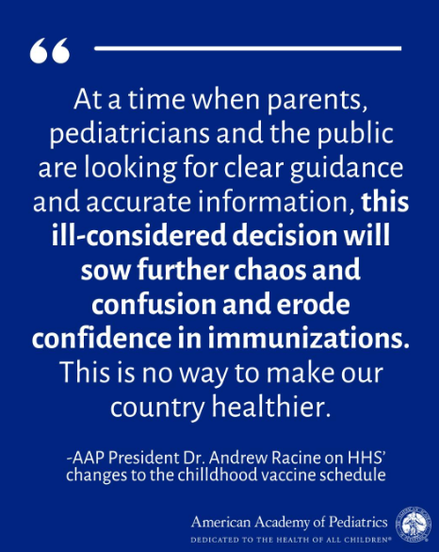
Notes:
“Today’s announcement by federal health officials to arbitrarily stop recommending numerous routine childhood immunizations is dangerous and unnecessary. The longstanding, evidence-based approach that has guided the U.S. immunization review and recommendation process remains the best way to keep children healthy and protect against health complications and hospitalizations. For decades, leading health experts, immunologists, and pediatricians have carefully reviewed new data and evidence as part of the immunization recommendation process, helping to keep newborns, infants, and children protected from diseases they could be exposed to in the United States as they develop and grow. Today’s decision, which was based on a brief review of other countries’ practices, upends this deliberate scientific process. During this uncertain time, the AAP will continue to publish our own childhood vaccine recommendations.”

Slide 19
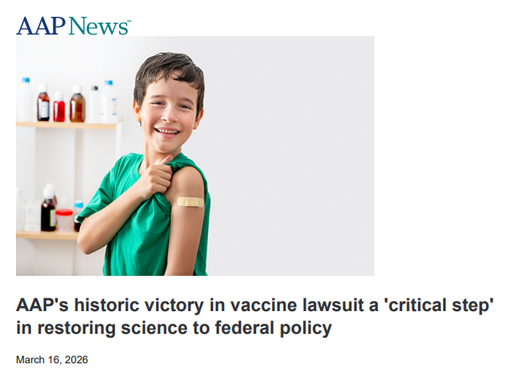
Notes:
AAP Vaccine Lawsuit Ruling: Key Takeaways (2026)
Federal vaccine changes blocked: Court halted a revised childhood immunization schedule during ongoing litigation
Advisory committee invalidated: ACIP members deemed unlawfully appointed; prior decisions paused
Scientific integrity at issue: Lawsuit challenges vaccine policy changes made without expert input or evidence
Major recommendations on hold: Includes COVID-19 guidance changes and removal of Hep B birth dose recommendation
AAP schedule remains trusted: Continues to recommend routine vaccines protecting against 18 diseases
Strong public health message: Reinforces that vaccine policy should be guided by evidence-based science, not politics

Slide 20
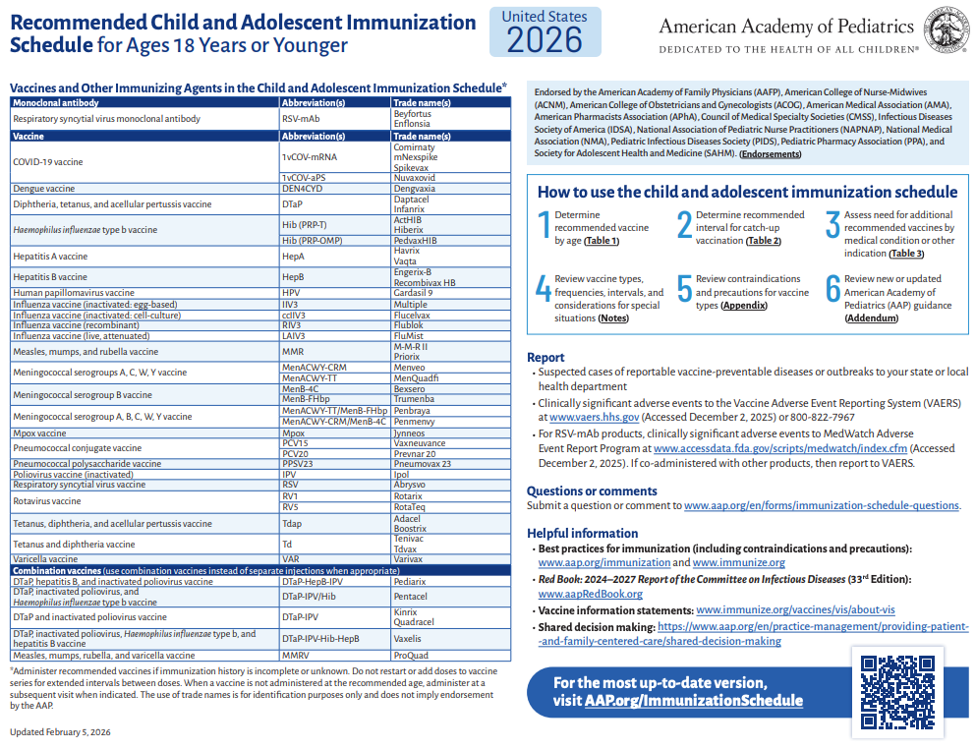


Slide 21
AAP Recommended Schedule
Provides guidance for routine vaccination of children and adolescents from birth through 18 years
Grounded in a rigorous review of safety, efficacy, and population health data
Notes:
https://www.healthychildren.org/English/safety-prevention/immunizations/Pages/Recommended-Immunization-Schedules.aspx

Slide 22
AAP Recommended Schedule
Broad Medical Support
Supported by 230+ organizations
Endorsed by 12 major national medical groups
Represents over 1 million healthcare professionals
Reflects strong scientific consensus
Notes:
https://www.healthychildren.org/English/safety-prevention/immunizations/Pages/Recommended-Immunization-Schedules.aspx

Slide 23
Clinical Rationale
Designed to provide protection before peak risk of exposure
Timing aligns with optimal immune response and disease epidemiology
Adhering to the schedule minimizes morbidity, mortality, and healthcare utilization
Notes:
https://www.healthychildren.org/English/safety-prevention/immunizations/Pages/Recommended-Immunization-Schedules.aspx

Slide 24
Safety & Administration
Vaccines undergo extensive pre-and post-licensure safety monitoring
The recommended schedule has no evidence supporting alternative or delayed schedules
Robust surveillance systems support ongoing safety evaluation
Notes:
https://www.healthychildren.org/English/safety-prevention/immunizations/Pages/Recommended-Immunization-Schedules.aspx

Slide 25
Managing Delays &
Catch-Up Vaccination
Catch-up schedules enable timely protection for children who fall behind
Every healthcare encounter should be used to access vaccination status and administer needed vaccines
Utilize standing orders, EHR prompts, and reminder/recall systems to improve coverage
Notes:
https://www.healthychildren.org/English/safety-prevention/immunizations/Pages/Recommended-Immunization-Schedules.aspx

Slide 26
Provider Influence & Communication
A strong, presumptive provider recommendation is the most influential factor in parental vaccine acceptance
Providers play a key role in countering misinformation and maintaining public trust
Notes:
https://www.healthychildren.org/English/safety-prevention/immunizations/Pages/Recommended-Immunization-Schedules.aspx

Slide 27
Key Takeaways
The AAP immunization schedule is evidence-based and widely endorsed
On-time vaccination offers the best protection against vaccine-preventable diseases
Catch-up vaccination is safe and recommended
Provider recommendation is critical to achieving high vaccination coverage
Staying current with annual updates ensures optimal patient care and public health impact
Notes:
https://www.healthychildren.org/English/safety-prevention/immunizations/Pages/Recommended-Immunization-Schedules.aspx

Slide 28
Resources

Slide 29
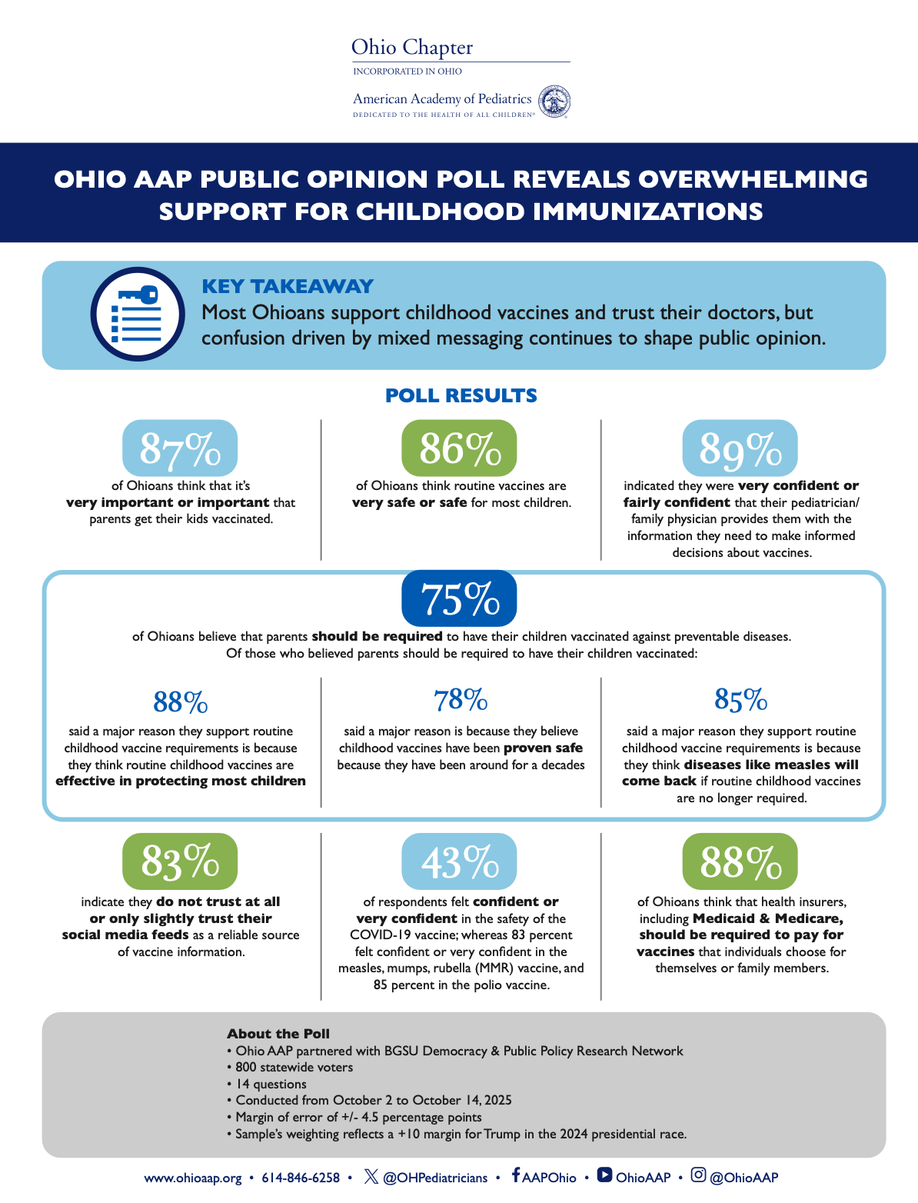

Ohio AAP Resources

Slide 30
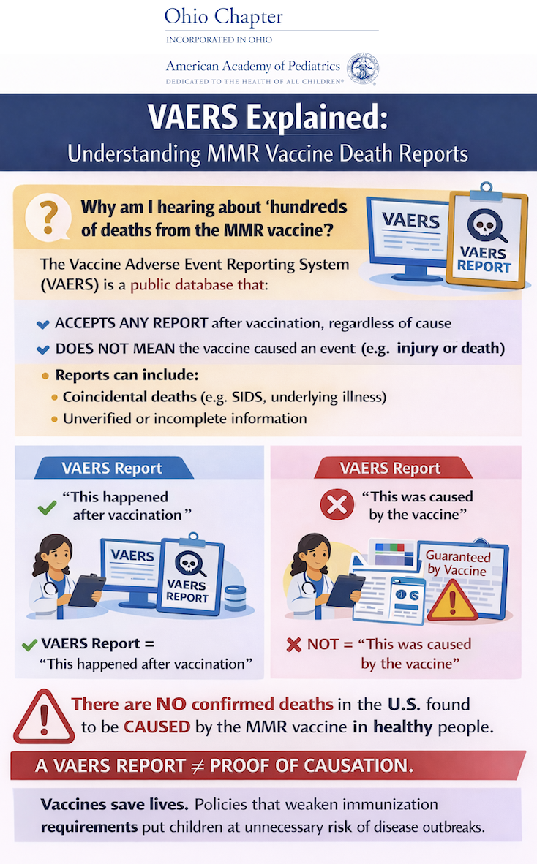
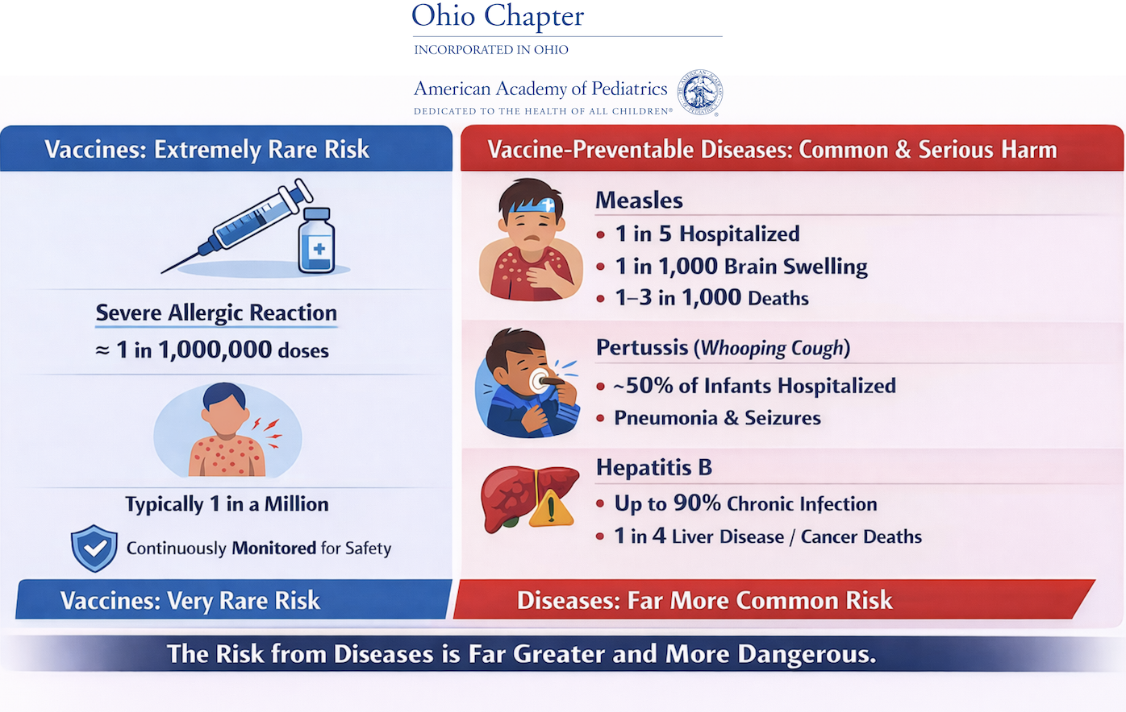
Ohio AAP Resources

Slide 31
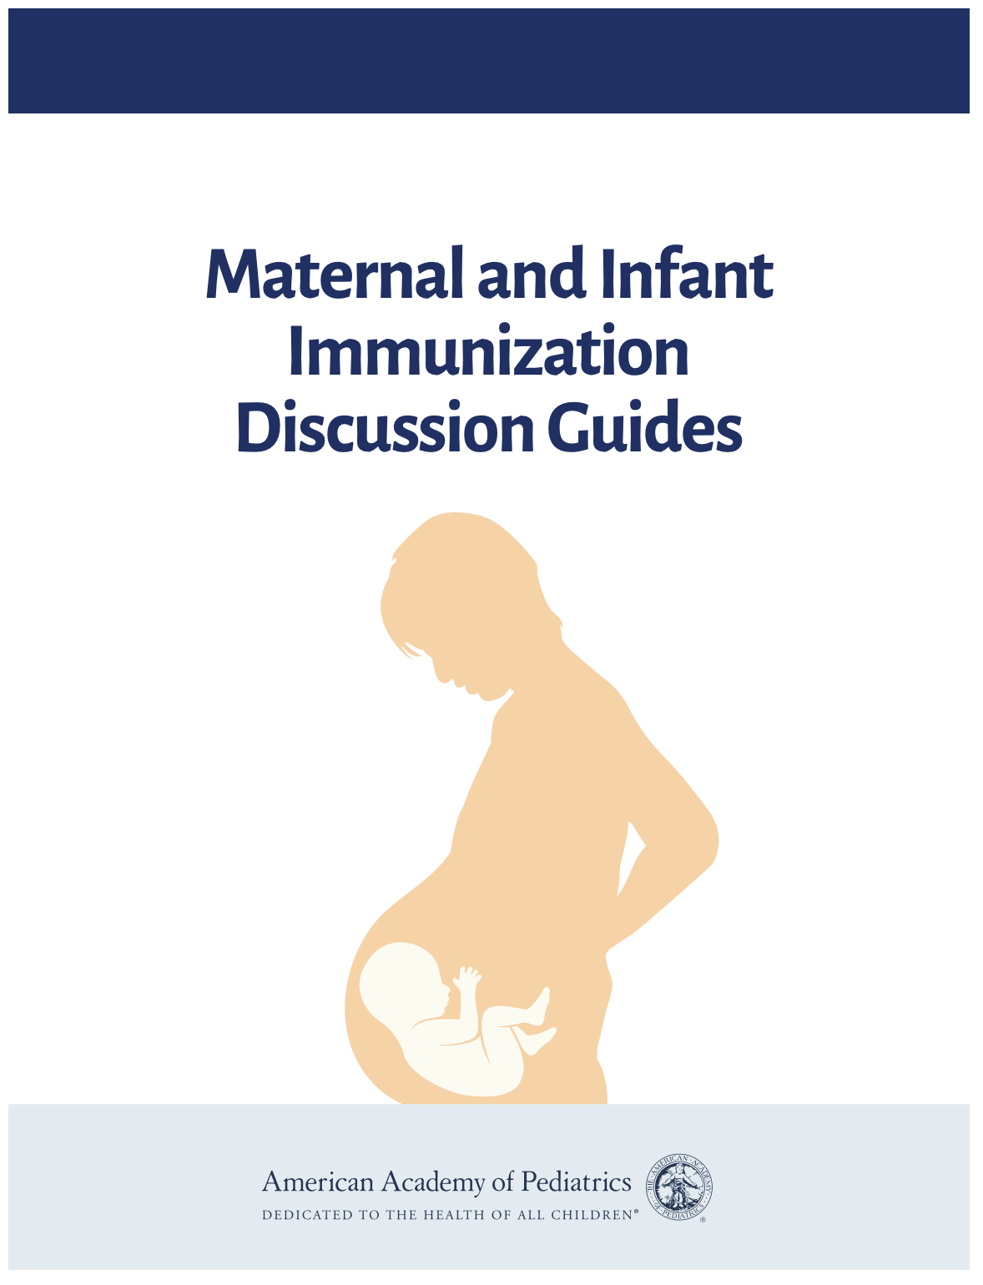
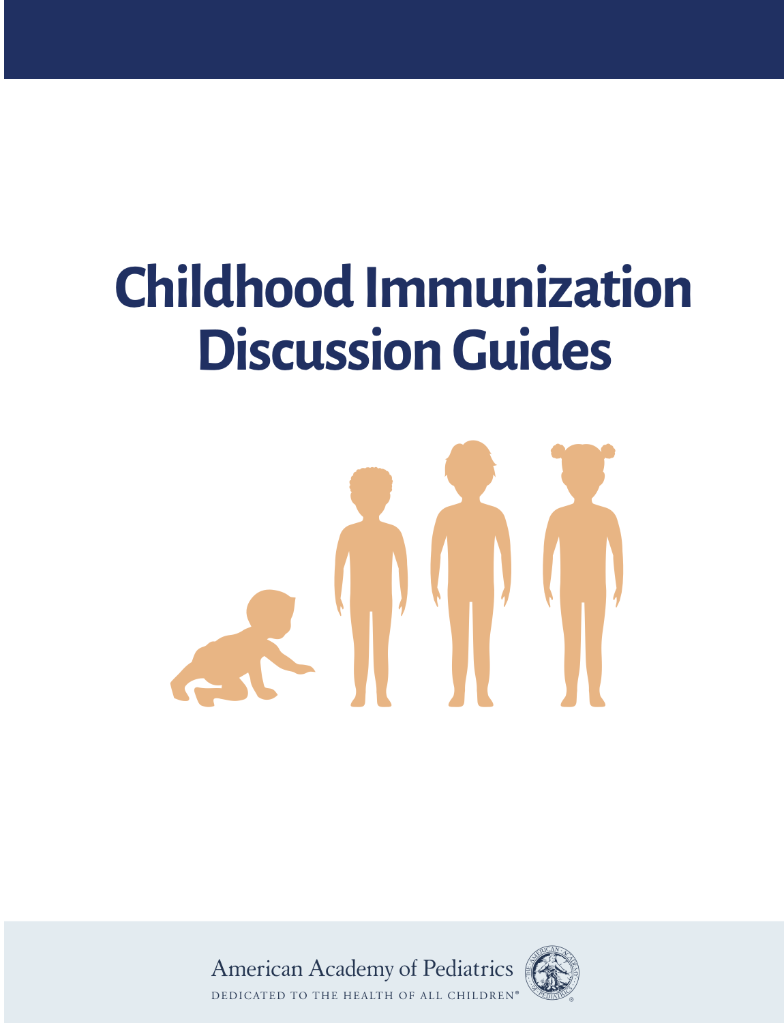
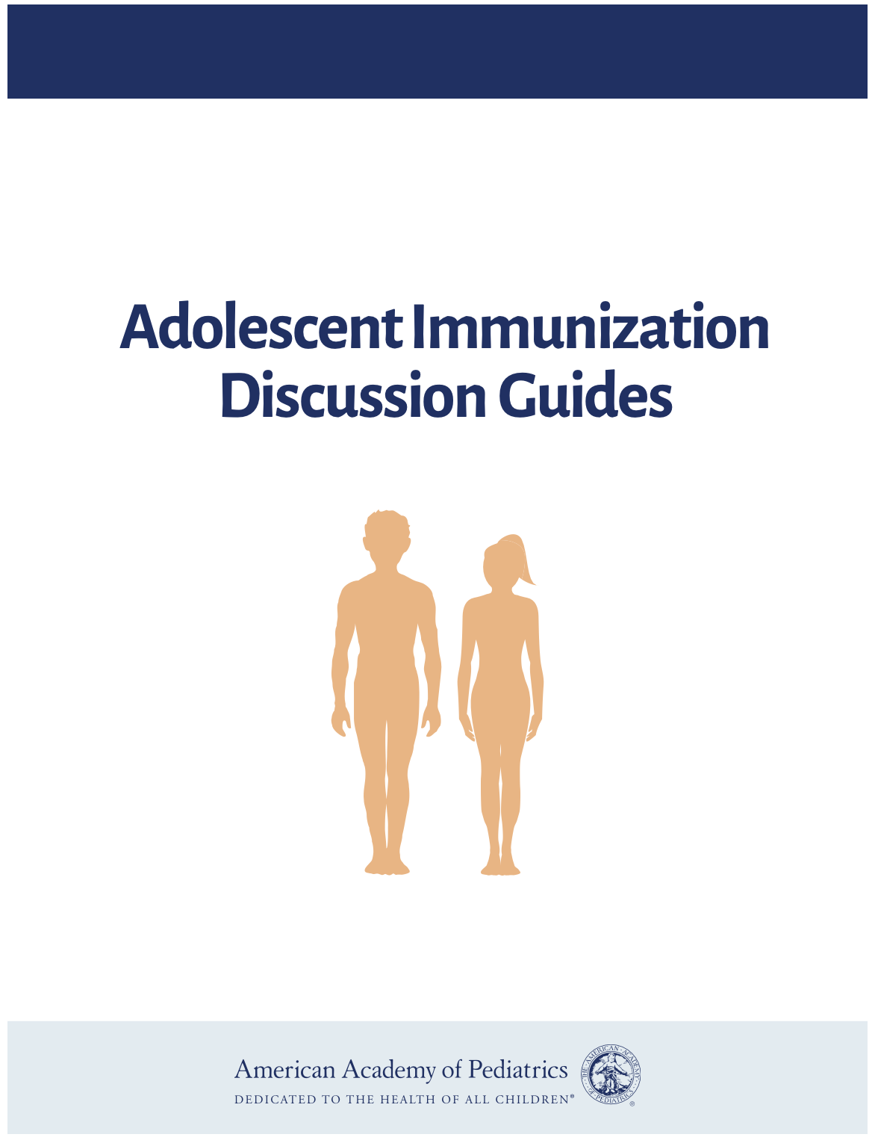
AAP Resources
Notes:
Promote efficient, productive conversations and explain what’s behind each recommendation with three immunization discussion guides. The maternal and infant guides focus on immunizations for young children and during pregnancy . The childhood guides focus on vaccines recommended from birth to age 6 years. The adolescent guides focus on preteens and teens age 9 through 18 years old. These resources help you pair helpful speaking points with family-friendly infographics.
Why use these resources?
To promote efficient, productive conversations with parents, while giving a strong recommendation for immunizations.
Information is backed by guidance developed by AAP immunization Subject Matter Experts.
They include speaking points for pediatricians and other primary care providers on all routinely recommended vaccines, as well as engaging infographics that display the information in a family-friendly way.

Slide 32
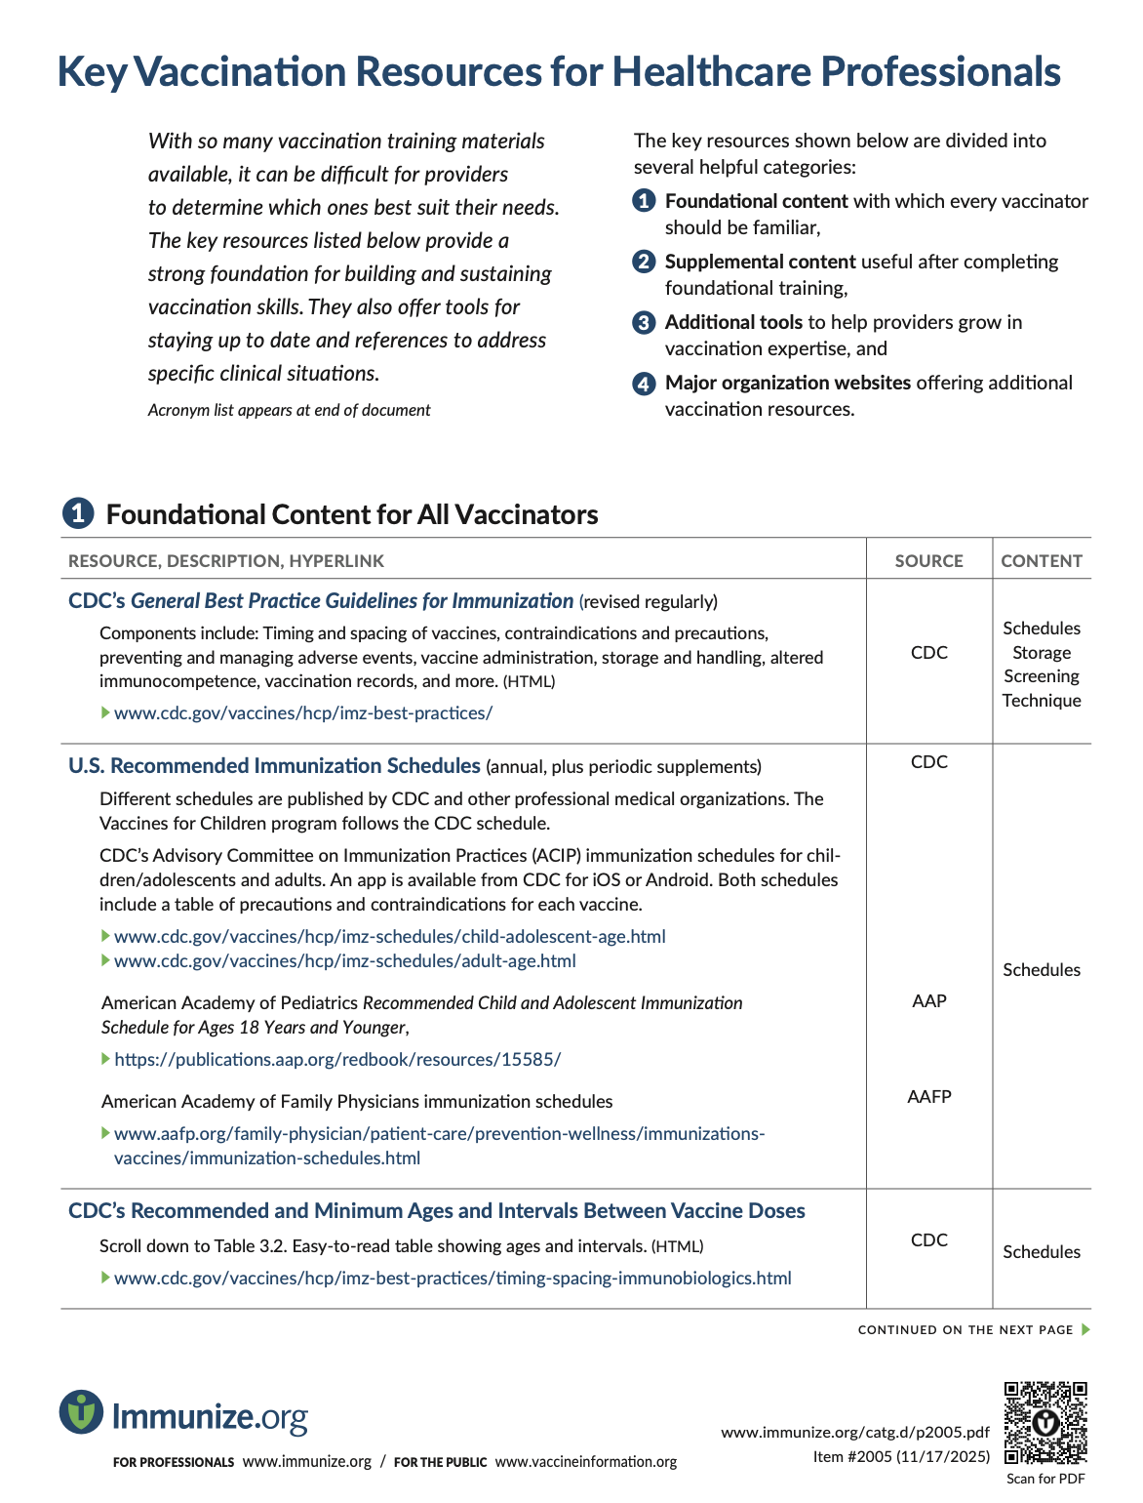
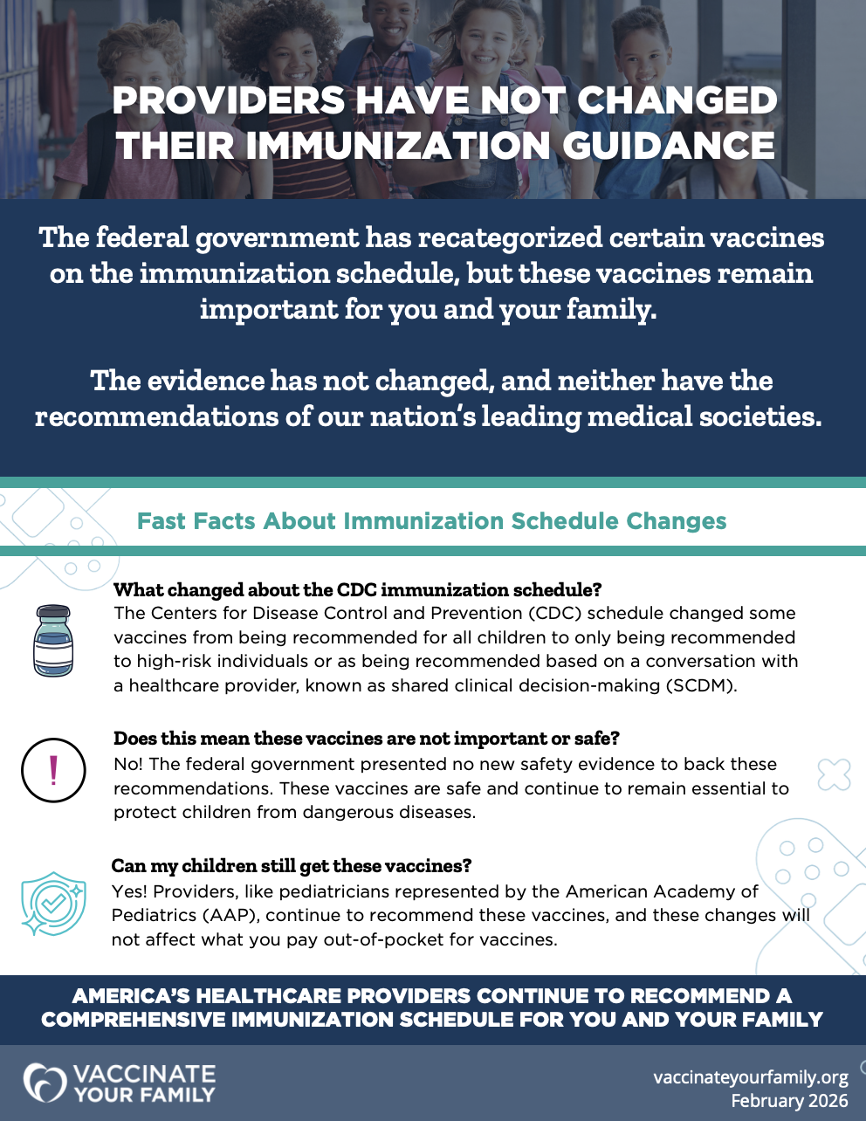
Partner Resources

Slide 33
Questions & Answers

Slide 34
Additional Questions?
Lory Sheeran Winland
Director of Immunization Programs
Ohio AAP
lwinland@ohioaap.org

Slide 35


